Slide 1

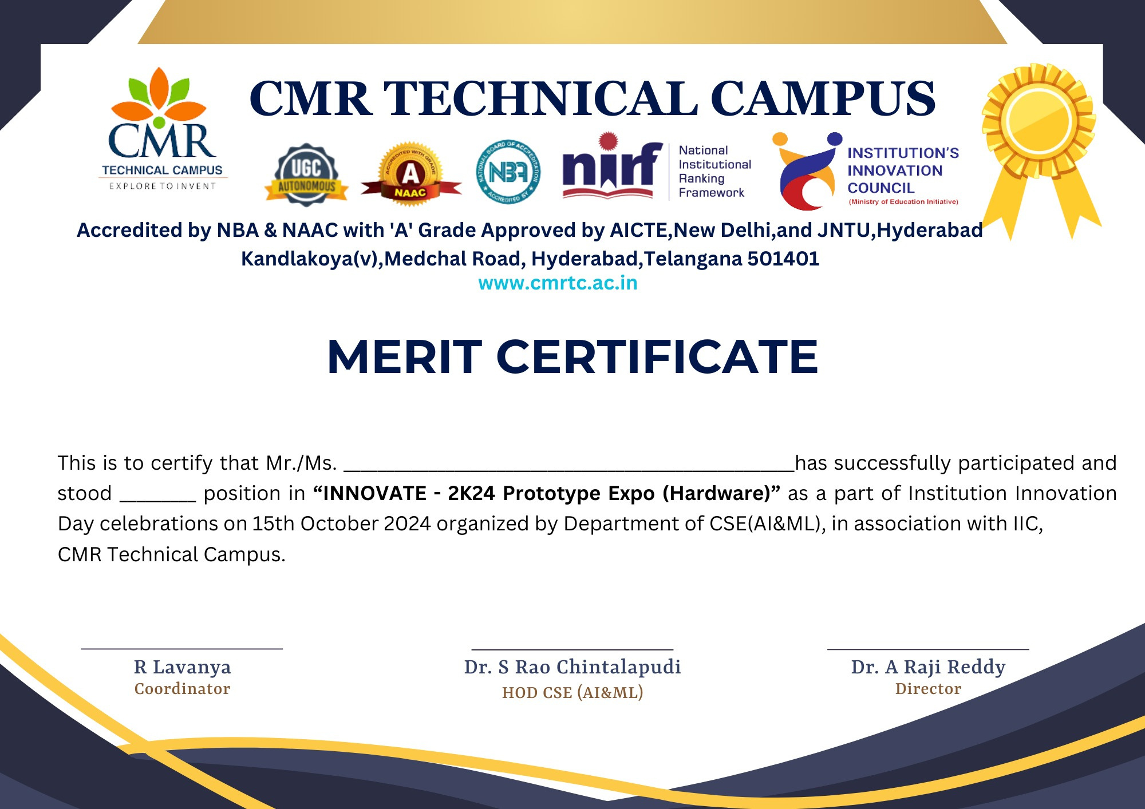
Real Time Research Project - 2026
SSL/TLS CERTIFICATE VALIDATION
By Batch F20
Y. Sahaja- 247R1A05CJ
C. William Immanuel Binny- 247R1A05Z8
M. Dileep Kumar Reddy- 257R5A0536
Under the Guidence of:
Bhavya Mam
Associate Professor

Slide 2
TABLE OF CONTENTS:
Introduction And Abstract
Existing System And Disadvantages
Proposed System And Advantages
Hardware Requirements & Software Requirements
System Architecture
UML Diagrams
UI Design
Conclusion
References

Slide 3
INTRODUCTION:
With the rapid growth of the internet, secure communication between users and websites has become very important. Sensitive information such as passwords, banking details, and personal data is transmitted over the internet every day. To protect this information from cyber threats, websites use security protocols like SSL (Secure Sockets Layer) and TLS (Transport Layer Security).
SSL/TLS certificates help establish an encrypted connection between the user’s browser and the web server. These certificates ensure that the website is authentic and that the data transmitted is secure.
However, many users are unaware of how to check whether a website’s certificate is valid or expired. This project introduces an SSL/TLS Certificate Validation Viewer, which allows users to easily view and verify certificate details such as issuer information, validity period, and encryption algorithm.
The system simplifies certificate verification and helps users understand the security level of a website before sharing sensitive information online.

Slide 4
ABSTRACT:
SSL/TLS certificates play a crucial role in ensuring secure communication over the internet. They help encrypt data and verify the authenticity of websites. However, many users are unaware of whether a website’s SSL certificate is valid or secure.
This project proposes an SSL/TLS Certificate Validation Viewer, which allows users to check the validity, issuer, expiration date, and encryption details of a website’s SSL certificate.
The system retrieves certificate information from a given URL and displays security details in a simple user interface. It helps users understand whether a website connection is secure or potentially unsafe.
A comprehensive SSL/TLS certificate validation and security assessment tool
Real-time analysis of website security posture
Multi-layered trust evaluation system
User-friendly web interface for instant security reports

Slide 5
EXISTING SYSTEM and DISADVANTAGES:
EXISTING SYSTEM:
1. Online SSL Checkers
2. Browser Built-in Indicators
3. Command-line Tools
4. Browser Extensions
Characteristics of Existing Systems:
Provide basic certificate information
Show expiry dates and issuer details
Grade SSL/TLS implementation
Often require technical expertise
Limited real-time revocation checking
Complex interfaces for non-technical users
Expensive enterprise-focused solutions
No unified trust score
DISADVANTAGES:
1. Complexity
2. Incomplete Information
3. User Experience Issues
4. Accessibility
5. Real-time Validation
6. Educational Gap

Slide 6
PROPOSED SYSTEM:
A unified, user-friendly SSL/TLS security scanner designed for both technical and non-technical users
Simplify Security Assessment
Comprehensive Analysis
Educational Component
Free and Accessible
ADVANTAGES:
1. User-Friendly
2. Comprehensive Security
3. Educational Value
4. Performance
5. Cost-Effective
6. Trustworthy
7. Actionable Insights

Slide 7
HARDWARE AND SOFTWARE REQUIREMENTS:
HARDWARE REQUIREMENTS:
Server Side:
Processor: Dual-core 2.0 GHz or higher
RAM: 2 GB minimum (4 GB recommended)
Storage: 500 MB for application + logs
Network: Broadband internet connection
Port: 443 (HTTPS) or 5000 (development)
Client Side:
Any device with modern web browser
Internet connection
No special hardware requirements
SOFTWARE REQUIREMENTS:
Backend:
-Python, Flask, Cryptography, Requests library, socket.
Frontend:
-HTML5,CSS3,Javascript
Development Environment:
Code Editor: VS Code / PyCharm
- Version Control: Git
- Testing: Postman, Browser DevTools
- OS: Windows/Linux/MacOS
Deployment:
Web Server: Gunicorn or uWSGI
- Reverse Proxy: Nginx (optional)
- SSL Certificate: Let's Encrypt
- Platform: Heroku/AWS/Digital Ocean

Slide 8
NOVELTY OF THE PROJECT:
1. Integrated Multi-Factor Trust Evaluation:
- First free tool combining ALL checks:
Certificate validity + Chain validation + Revocation status
TLS protocols + Cipher strength + CT logs
Single unified trust score
2. Real-Time OCSP/CRL Checking:
Most free tools skip revocation checking
We query OCSP responders directly
Download and parse CRLs
Immediate revocation detection
3. Educational Focus:
Not just a scanner - a learning tool
Plain English explanations
Contextual security warnings
Actionable recommendations

Slide 9
4. Transparent Scoring Algorithm:
Open methodology (no black box)
Deductions clearly explained
Users understand their score
Reproducible results
5. Zero-Installation Web Interface:
Runs entirely in browser
No software to install
Cross-platform compatibility
6. Privacy-Conscious:
No data storage
No user tracking
Minimal logging
Client-side rendering
7. Academic Research Value:
Demonstrates PKI infrastructure
Shows X.509 certificate parsing
Implements cryptographic protocols
Real-world cybersecurity application

Slide 10
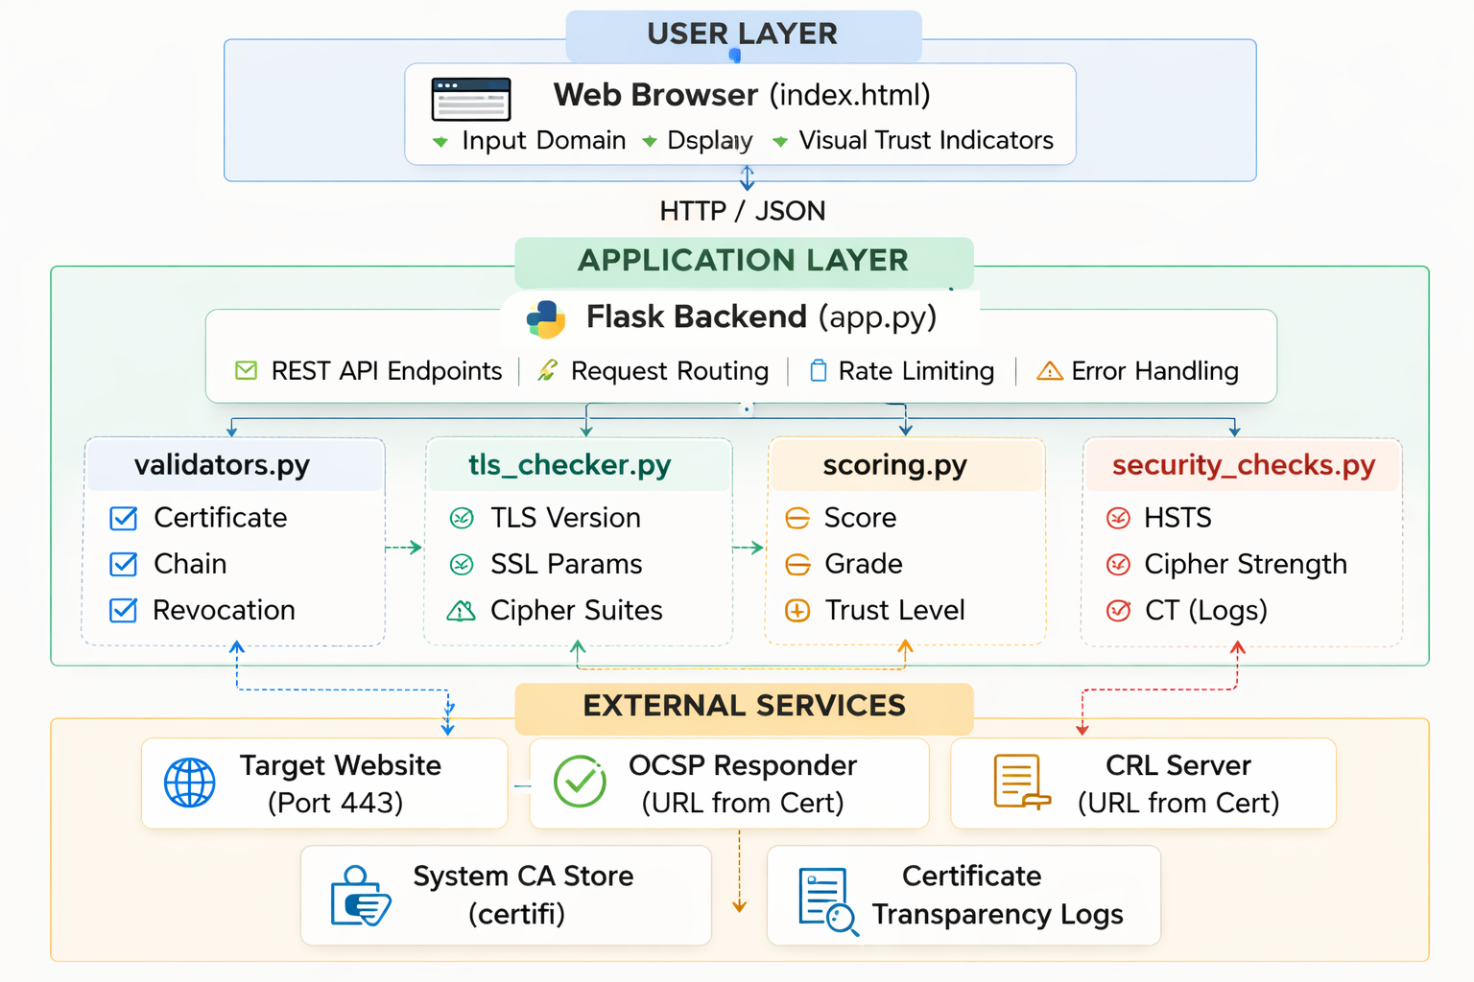
Architecture:

Slide 11
MODULES:
1.Certificate Information Module
2.TLS Protocol checker Module
3.Scoring and Trust Module
4.Security checks Module
5.Frontend Module

Slide 12
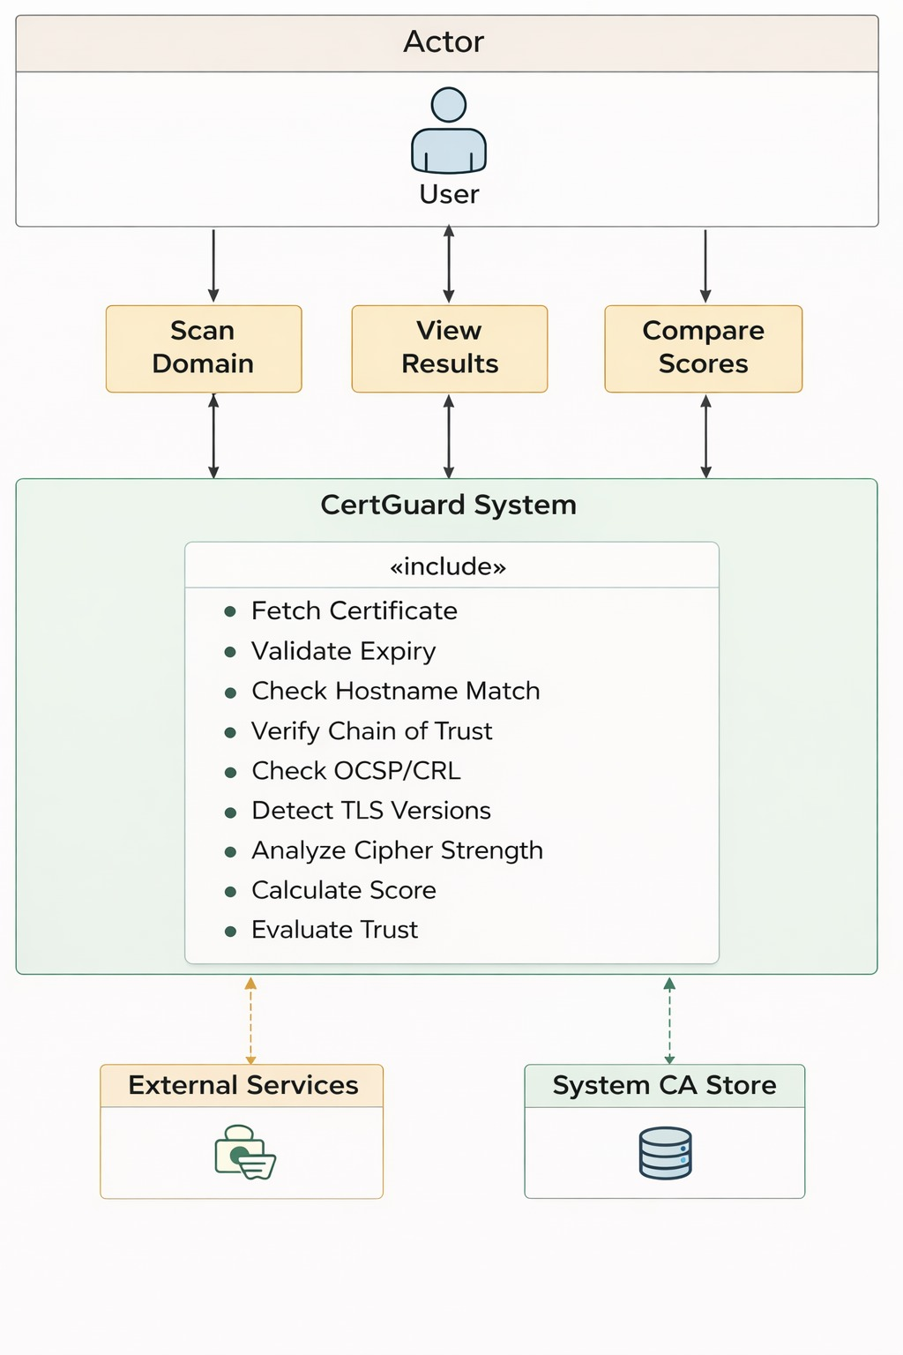
UseCase Diagram:

Slide 13
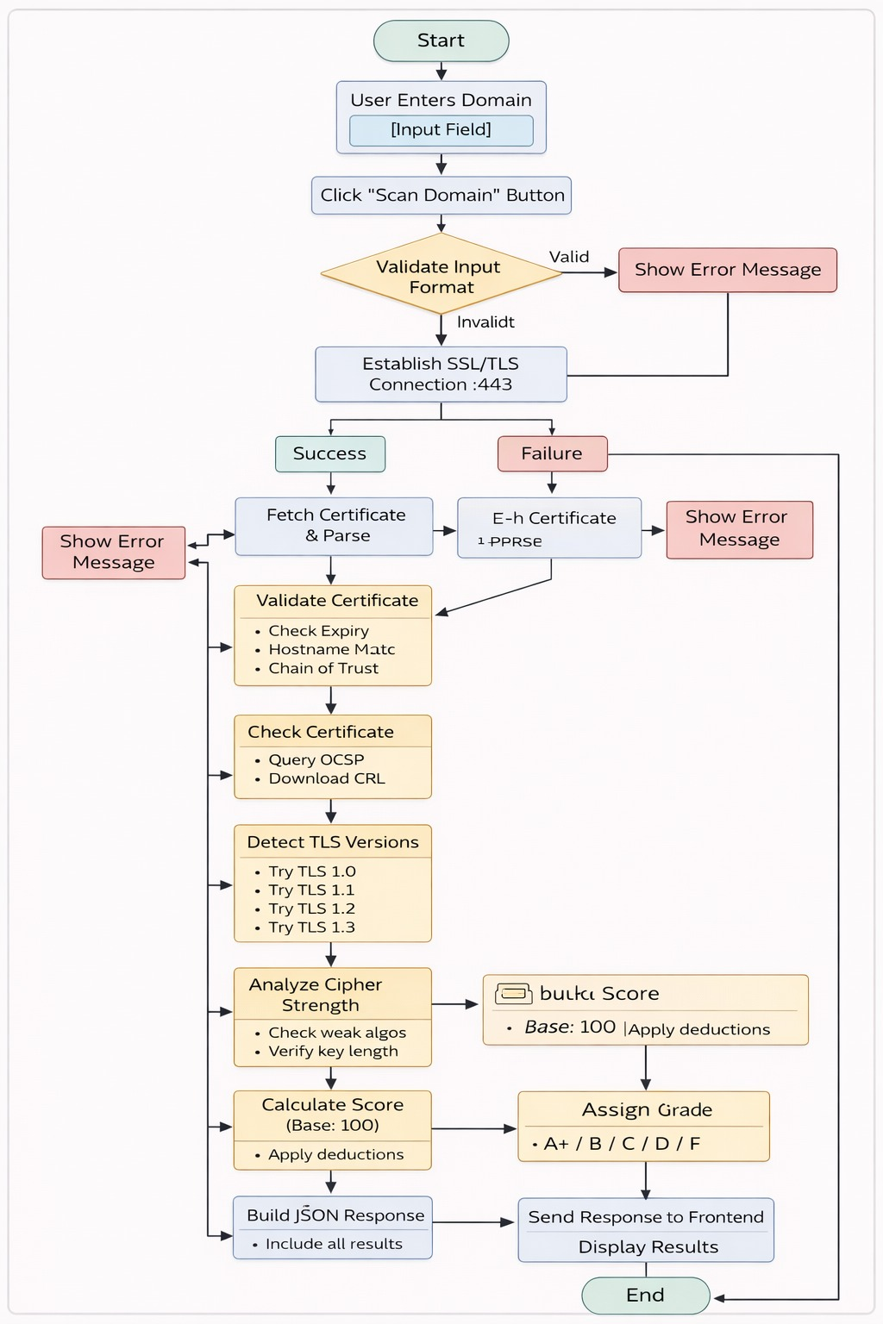
ACTIVITY DIAGRAM:

Slide 14
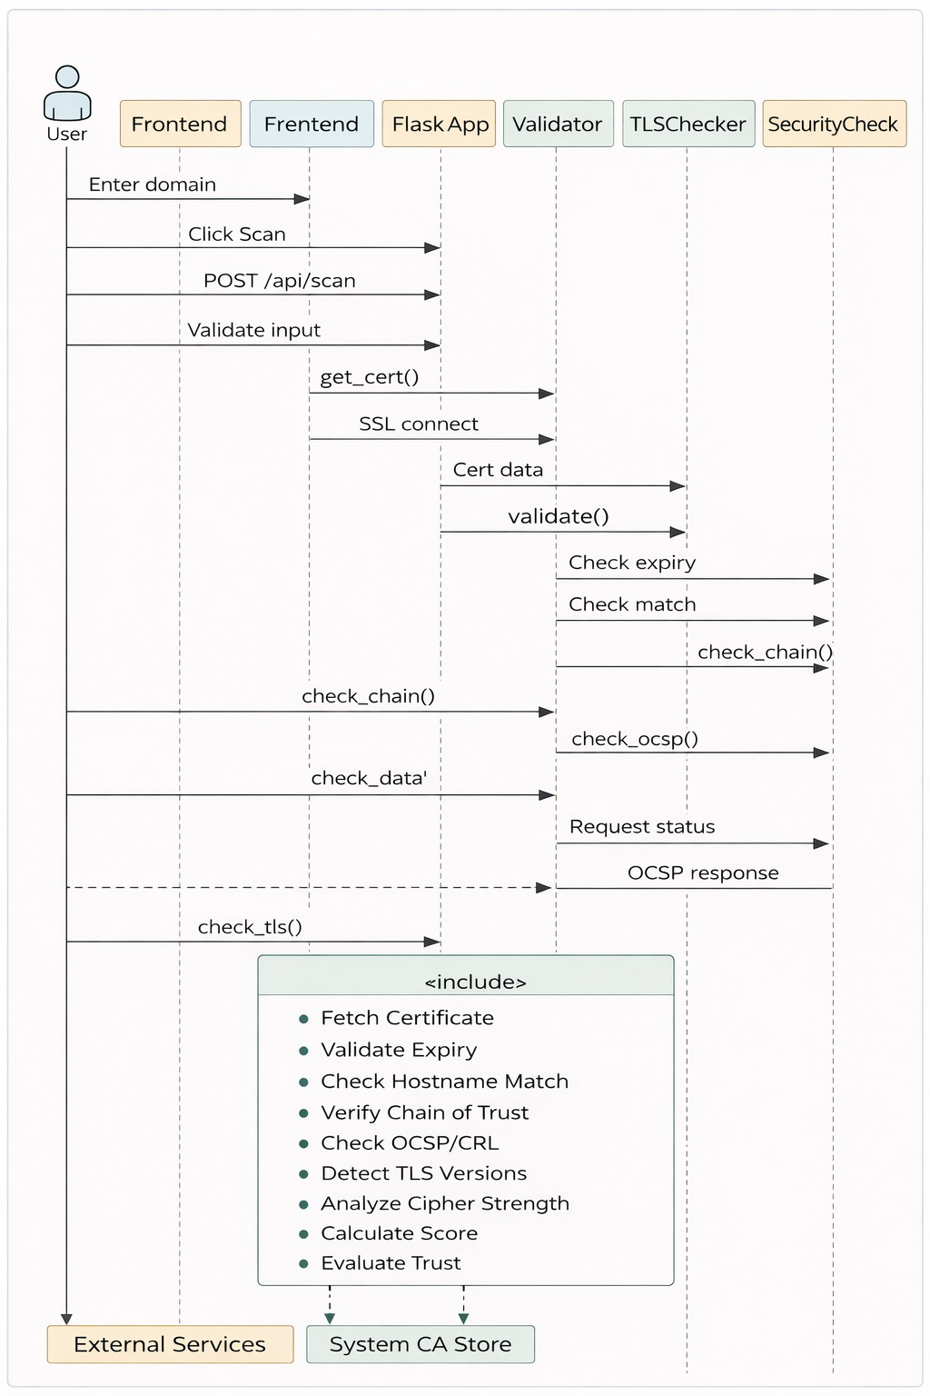
SEQUENCE DIAGRAM:

Slide 15
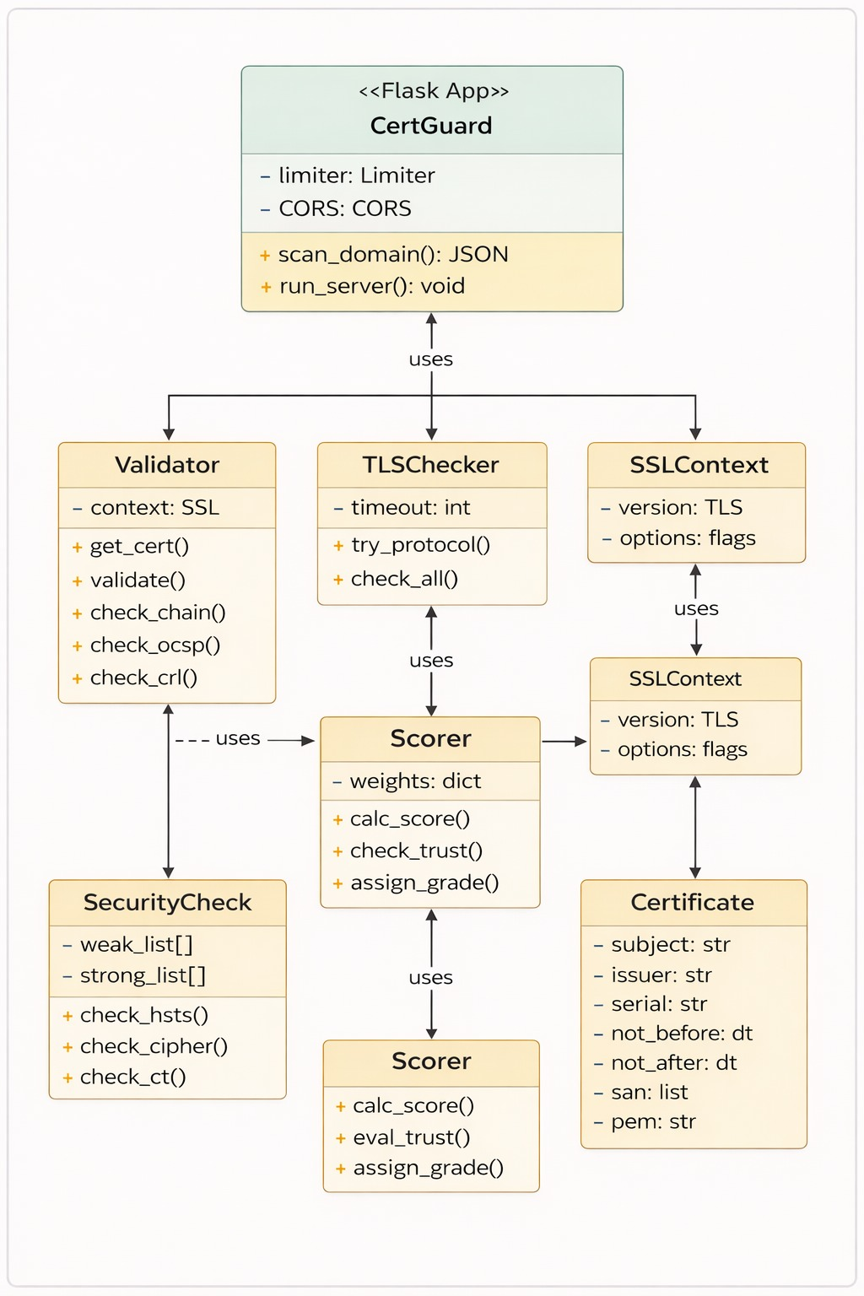
Class Diagram:

Slide 16
Outputs:

Slide 17
CONCLUSION:
Comprehensive Solution: Complete SSL/TLS security analysis
User-Friendly: Accessible to non-technical users
Educational: Teaches security best practices
Free & Open: No cost, no barriers
Real-Time: Live OCSP/CRL verification
Transparent: Clear scoring methodology

Slide 18
REFERENCES:
Transport Layer Security (TLS) Documentation
– Official documentation explaining how TLS provides secure communication over networks.
Secure Sockets Layer (SSL) Protocol Resources
– Information about SSL certificates and encryption mechanisms used in secure websites.
OpenSSL Documentation
– Tools and libraries used for implementing SSL/TLS protocols and retrieving certificate information.
GitHub Documentation
– Used for project version control and code hosting.
Cybersecurity Research Articles and Online Resources
– For understanding SSL certificate validation and secure web communication.

Slide 19
Thank You..

